Slide 1
CSE 232 – Tutorial
06-09-23

Slide 2
Building a TCP receiver (Assignment-2)
Topics:
  Building Bytestream
  Building Reassembler
  Building TCP receiver

Slide 3
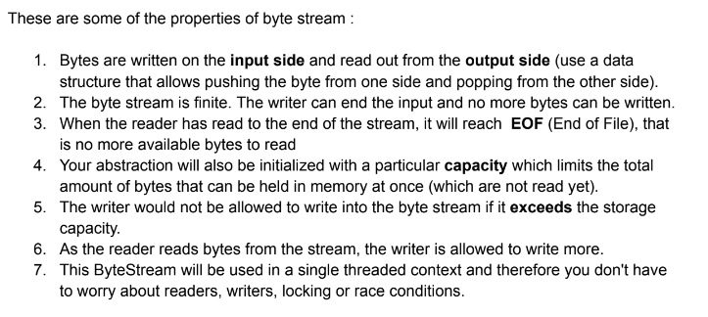
Building ByteStream
What is ByteStream?
A container that stores a collection of bytes from which bytes can be read or written to.
Notes:
Talk about the read write functions and how exactly is the bytestream working.
Do we ignore the entire substring if part of the substring cant be added to the Bytestream.

Slide 4
String: abcdefgh
Input
h
g
f
e
d
c
b
a
Output

Slide 5
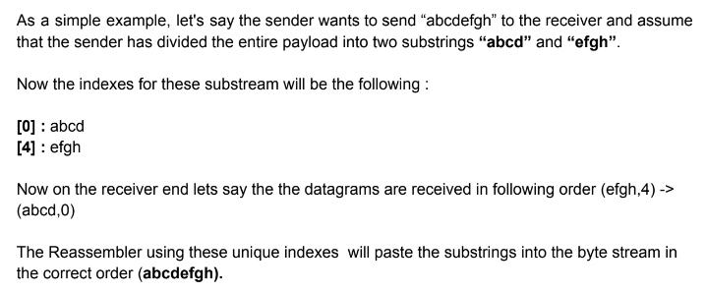
Re-assembler
Notes:
Only need to explain the necessity of storing when the current substring cant be directly added to the stream when the index is not the ack index.

Slide 6
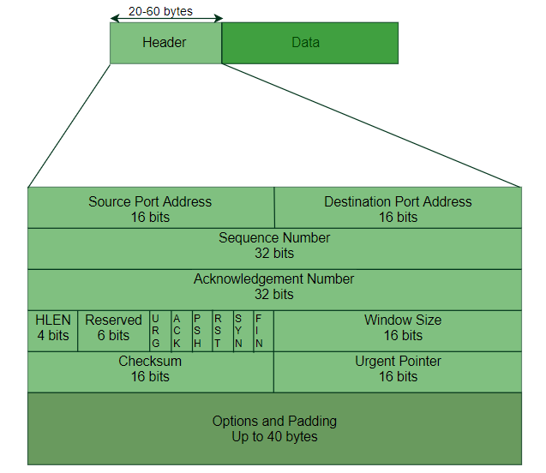
TCP-Receiver
Segment
Notes:
talk about the TCP segment that they would be receiving. Talk about the difference between sequence number and the index. What are the properties and behaviour of the sequence number. How can they use the sequence number to calculate the index.Also, tell a little bit about how after they have calculated the index, they need to use the Reassembler to push the substring into the byte stream.Also talk about the wrap and unwrap functions, what exactly are they doing.

Slide 7
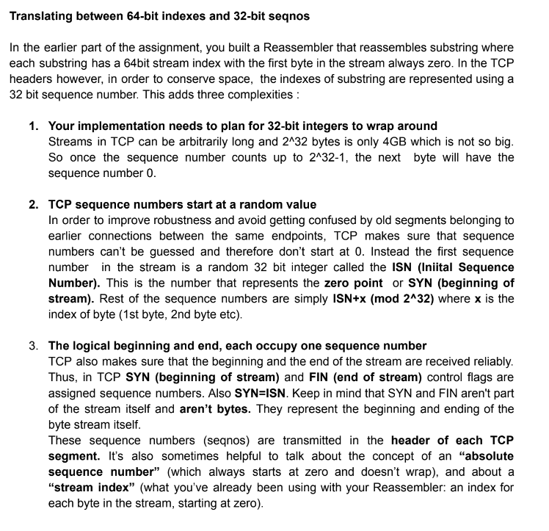

Slide 8
